Slide 1
Deep Learning in Computer Vision (Part-3)
Recurrent Neural Networks
Computer Vision, 6th Semester, 2024

Slide 2
Introduction to R.N.N.
RNN - an artificial neural network designed to recognize patterns in sequences of data, like text, time series, or anything where the order of inputs matters.
Traditional neural networks process data in a feedforward manner (passing data from input layers through hidden layers to output layers).
RNNs have connections that loop backward, meaning they can hold information in their memory.
This looping mechanism allows RNNs to exhibit temporal dynamic behavior, making them particularly useful for tasks involving sequential data.

Slide 3
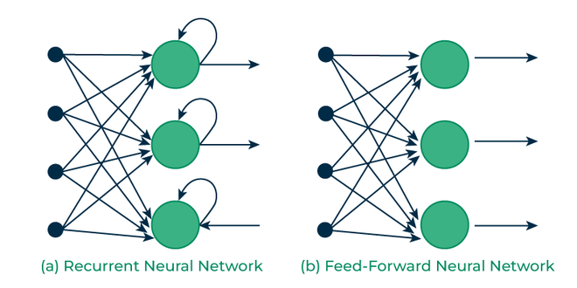
RNN vs FFNN

Slide 4
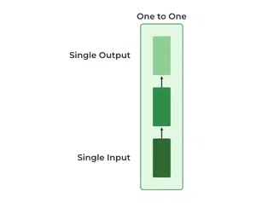
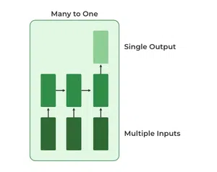
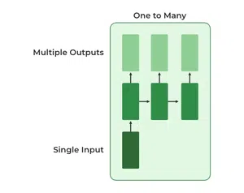
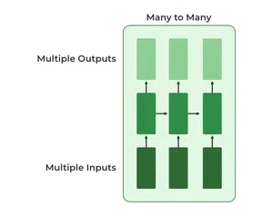
Types of RNN
Vanilla Neural Network
Sentiment Analysis Model
Image Captioning Model
Language Translation Model

Slide 5
Issues with using RNN
Computational cost:
Dealing with high-resolution images or long video sequences.
Techniques like data augmentation and batch processing can help manage this.
Ensuring that the RNN effectively captures temporal dependencies without overfitting or underfitting (tuning of hyperparameters).
Vanishing and Exploding Gradients

Slide 6
Gradient Descent
Optimization algorithm used to train the network by adjusting its parameters (weights) to minimize a given loss function
In RNNs, training involves processing sequences of input data and updating the network parameters based on the error calculated at each time step.
Training an RNN: backpropagation through time (BPTT)
gradients of the loss function with respect to the network parameters are calculated and used to update the weights.

Slide 7
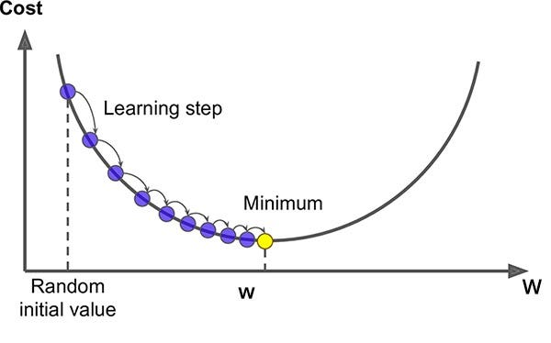
Gradient Descent

Slide 8
Gradient Descent – Forward Pass
The RNN processes the input sequence one time step at a time, producing outputs at each time step.
The output at each time step is calculated based on the current input and the previous hidden state, which captures information from earlier time steps.

Slide 9
Gradient Descent – Backward Pass
Error (difference between predicted and actual outputs) is calculated using a loss function.
The gradients of this error with respect to the network parameters (weights) are then computed through backpropagation.
In RNNs, backpropagation through time involves unrolling the network over the entire sequence and propagating the gradients backward through EACH TIME STEP.

Slide 10
Vanishing Gradient
The gradients become extremely small as they flow backward through the network during training.
This means that the gradients for the weights in the earlier layers become close to zero or vanish.
Then the weights in the earlier layers of the network are not updated effectively because the gradient signal is too weak.
If these weights are less than 1 (often due to activation functions and weight initialization), the gradients can diminish exponentially as they propagate backward through time.
This can significantly slow down or even halt the learning process for those layers.

Slide 11
Exploding Gradient
Gradients become excessively large during training.
This can lead to unstable training dynamics, where the weights are updated by very large amounts, causing the loss function to oscillate or diverge.
If these weights are greater than 1, the gradients can explode exponentially as they propagate backward through time.
The weight updates get too large and destabilizing the training process.

Slide 12
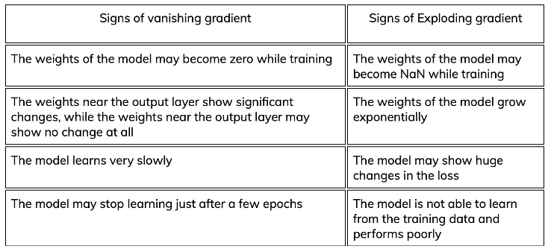
Gradient Issues

Slide 13
Solution to gradient issues
Gradient clipping:
Scaling gradients during backpropagation to prevent them from becoming too small/large.
By setting a threshold for the gradient magnitude, you can clip or limit the gradients to a manageable range, preventing them from exploding/vanishing.
Weight regularization techniques to help prevent the weights from becoming too small/large during training.
Careful weight initialization strategies to ensure that the initial weights are not too small/large.
Using architectures like Long Short-Term Memory (LSTM) networks or Gated Recurrent Unit (GRU) networks
Specifically designed to mitigate both vanishing and exploding gradient problems
Incorporating gating mechanisms to control the flow of information through the network.
Skip connections or residual connections
Allow gradients to flow more easily through the network by providing shortcut connections.

Slide 14
Long Short term Memory Networks (LSTM)
The core components of an LSTM unit:
Cell State:
The "memory" of the LSTM unit
Store information over long sequences.
The cell state runs straight down the entire chain of the LSTM
Three Gates:
Forget Gate
Input Gate
Output Gate
Hidden State: The output of the LSTM unit; based on the cell state but filtered through the output gate.
Gate | Description | Input | Output
Forget | Decides what information to discard from the cell state | Current input and previous hidden state | Value between 0 and 1 for each element in the cell state (how much of corresponding cell state element should be kept)
Input | Determines what new information to store in the cell state | Current input and previous hidden state | Sigmoid layer decides which values to update; tanh layer creates a vector of new candidate values to add to cell state
Output | Determines what information to output | Current input and previous hidden state | Control over extent of updated cell state used to compute output of the LSTM unit

Slide 15
L.S.T.M.

Slide 16
L.S.T.M.

Slide 17
Gated Recurrent Unit (GRU)
The key components of a GRU unit:
Update Gate
Reset Gate
Candidate Hidden State:
Computed based on the input at the current timestep and the reset gate.
It represents the new candidate hidden state that will be combined with the update gate to produce the final hidden state.
Final Hidden State:
Computed by combining the candidate hidden state with the update gate.
It represents the output of the GRU unit and is passed to the next timestep or used for downstream tasks.
Gate | Description | Input | Output
Update | Controls how much of the past information should be passed along to the future | Input at current timestep and hidden state from previous timestep | Update gate value between 0 and 1 for each element in the hidden state
Reset | Determines how much of the past information to forget | Input at current timestep and hidden state from previous timestep | Reset gate value between 0 and 1 for each element in the hidden state

Slide 18
G.R.U.

Slide 19
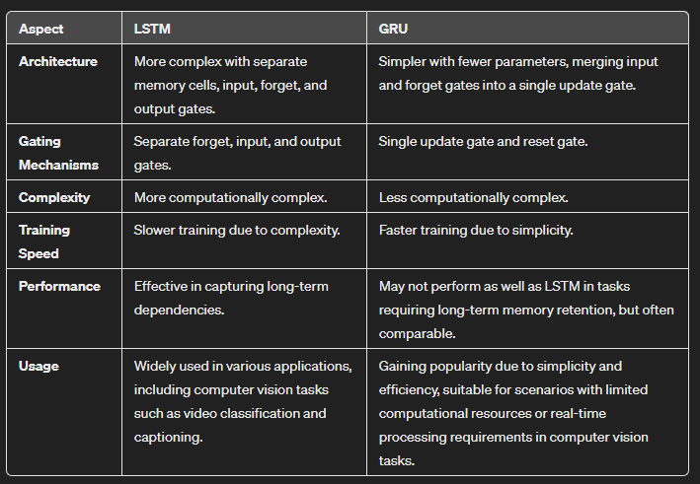
LSTM vs GRU
Both are advancements on the vanilla RNN to tackle vanishing and exploding gradients, but they differ in the given points.

Slide 20
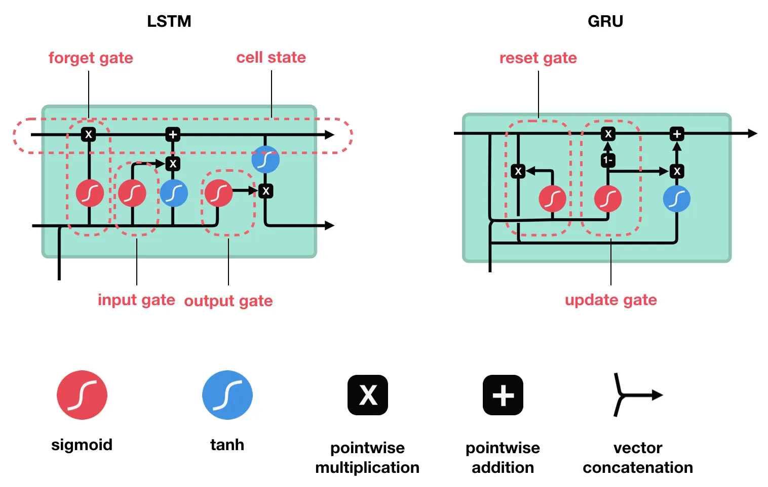
LSTM vs GRU

Slide 21
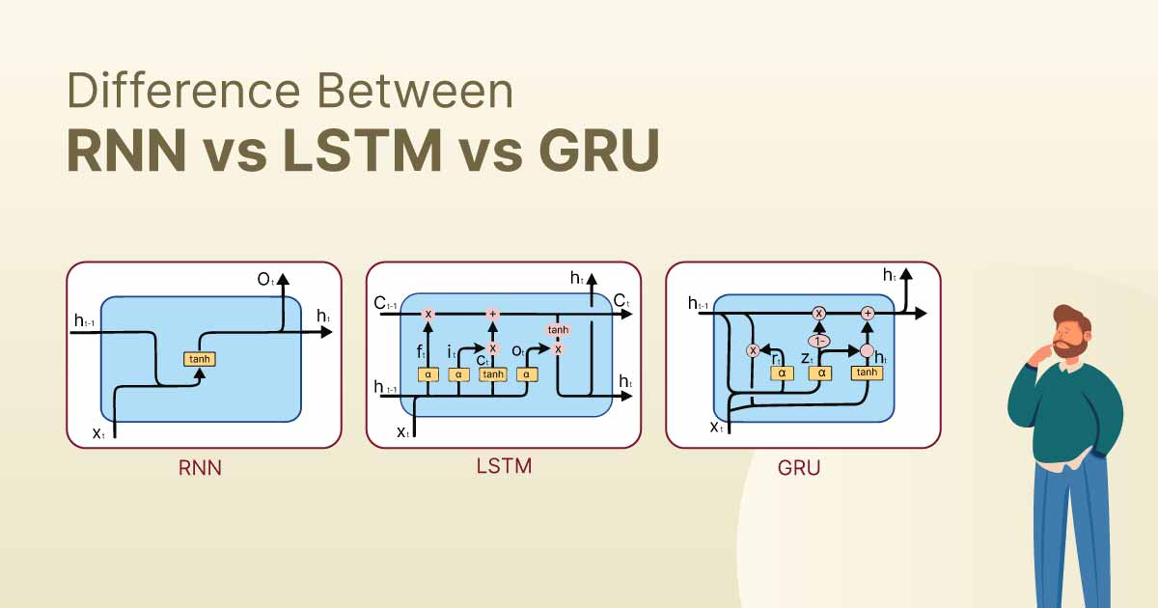
RNN vs LSTM vs GRU

Slide 22
RNN in Computer Vision
Convolutional Neural Networks (CNNs): primary architecture for computer vision tasks
Ability to effectively learn spatial features from images.
Scenarios in computer vision where the temporal order of data matters:
Video analysis
Action recognition
Generating image descriptions
RNNs can capture temporal dependencies in sequential data, making them suitable for tasks where understanding the sequence of frames or images is crucial.

Slide 23
Applications of RNN in Computer Vision
Video Analysis:
RNNs can analyze videos frame by frame, capturing temporal patterns and dynamics.
E.g. action recognition in videos, video captioning
Image Captioning:
RNNs can generate descriptions for images by processing them sequentially.
They can learn to generate captions that describe the content of the image.
Useful for tasks like image understanding and accessibility.
Visual Question Answering (VQA):
In VQA tasks, the model is required to answer questions about images.
RNNs can process both the image features extracted by CNNs and the sequential nature of the questions to generate answers.

Slide 24
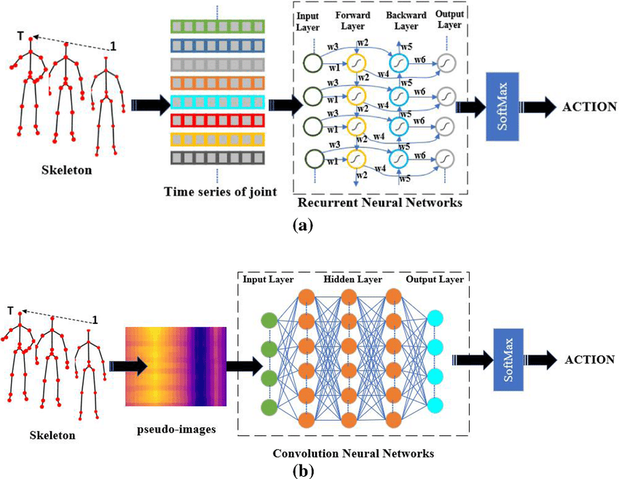
Action Recognition using RNN
Feng, Liqi & Zhao, Yaqin & Zhao, Wenxuan & Tang, Jiaxi. (2022). A comparative review of graph convolutional networks for human skeleton-based action recognition. Artificial Intelligence Review. 55. 10.1007/s10462-021-10107-y.

Slide 25
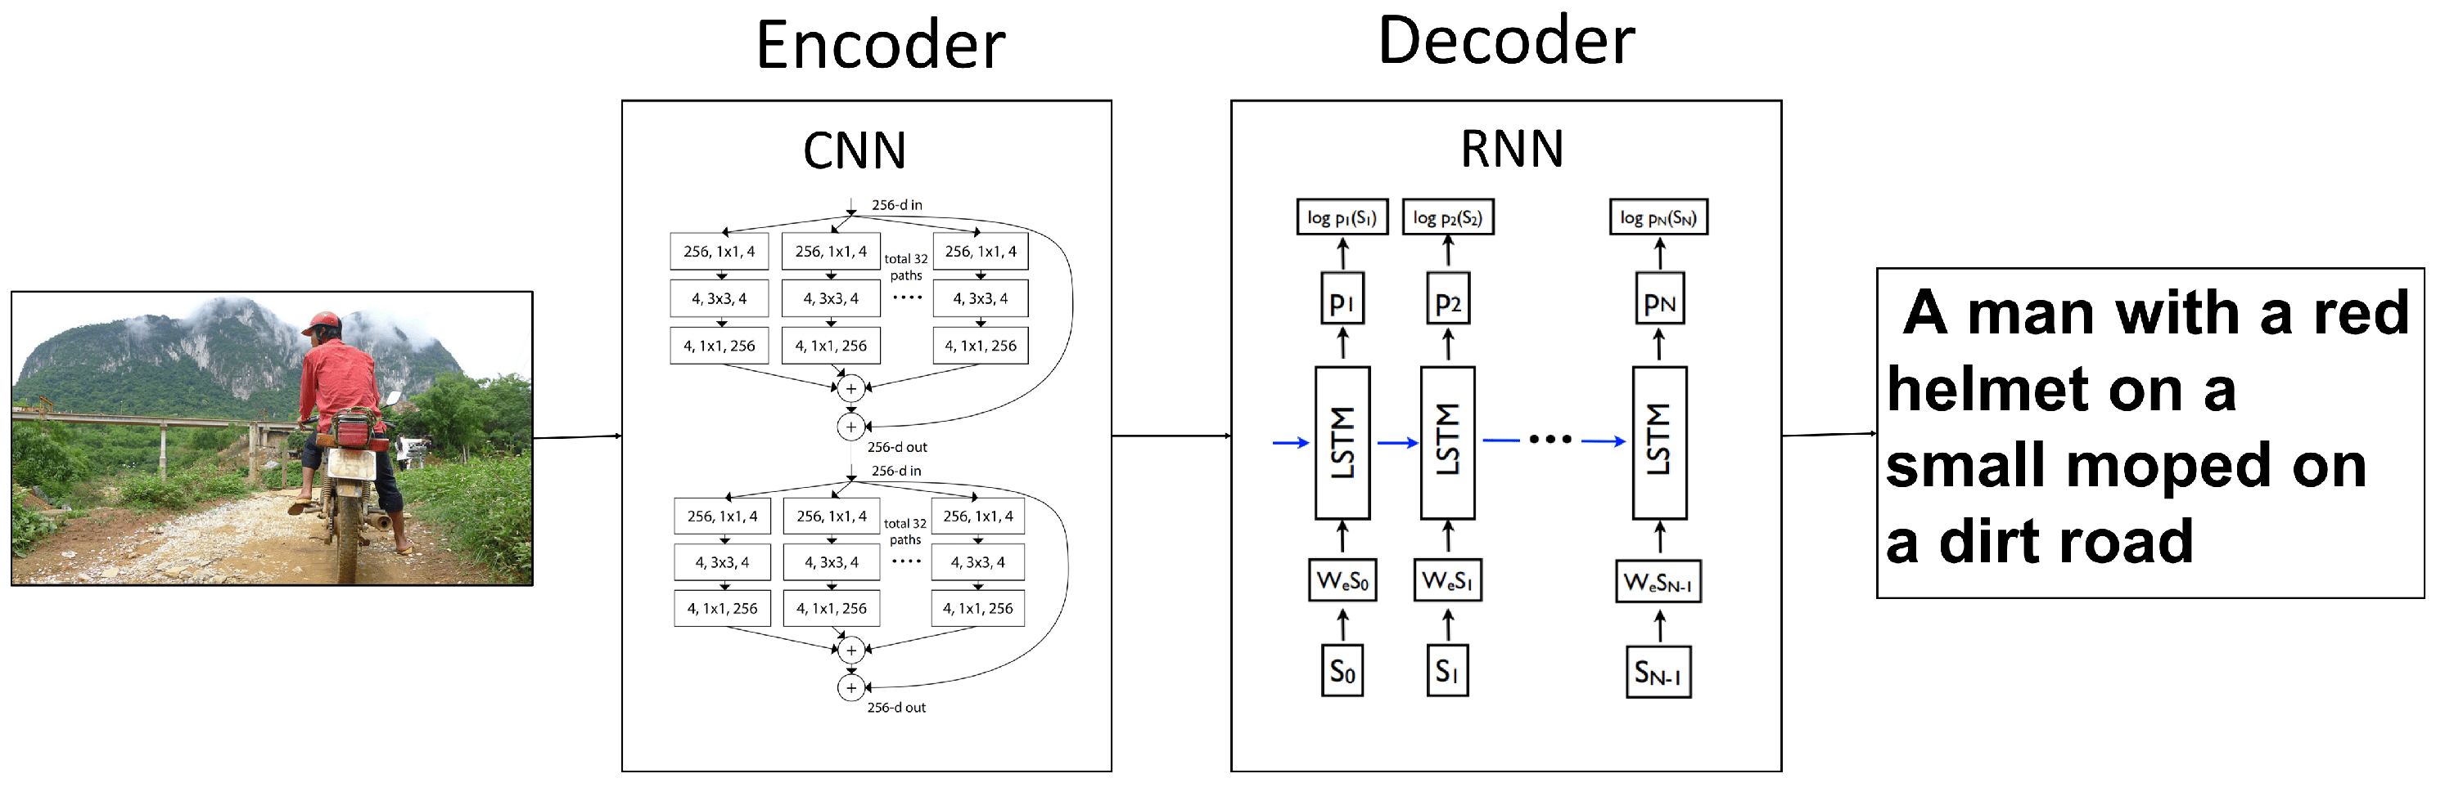
Image Captioning using RNN
Zhu, X.; Li, L.; Liu, J.; Guo, L.; Fang, Z.; Peng, H.; Niu, X. Image Captioning with Word Gate and Adaptive Self-Critical Learning. Appl. Sci. 2018, 8, 909. https://doi.org/10.3390/app8060909

Slide 26
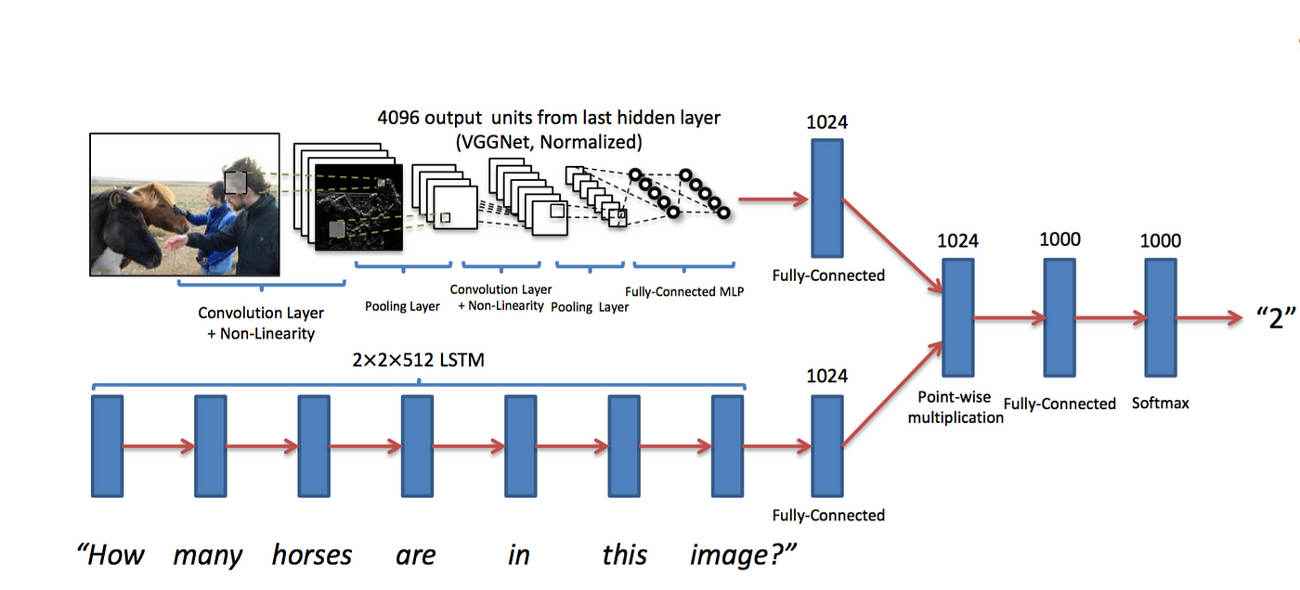
Visual Question Tasks using RNN

